Slide 1
Human Capital Management (HCM)
Curriculum: Introduction to S/4HANA using Global Bike

Slide 2

4.3 (July 2025)
S/4HANA 2023
Fiori 3.0
Global Bike
No Prerequisites needed

Slide 3
Claudia Kroliczek
Mark Lehmann
Stefan Weidner
Babett Ruß
Lutz Kleinsorge
Beginner

Slide 4
You are able to
define the central organizational structures of the HCM module.
summarize the master data which is most important for the HCM module.
explain standard HCM processes.

Slide 5

Agenda
HCM Organizational Structure
HCM Master Data
HCM Processes
  Organizational Management
  Personnel Administration
  Personnel Development
  Personnel Controlling
  ESS/MSS

Slide 6







HCM Organizational Structure
Represents the structural and personnel organization of a company
Consists of organizational units
Illustrates the organizational structures and hierarchies
Illustrates an employees responsibilities
Is a precondition of various personnel processes’ implementation
Consists of three parts:
  Enterprise Structure
  Personnel Structure
  Organizational Plan

Slide 7
HCM Enterprise Structure
Enterprise Structure
  Represents formal and financial structures in a company
  Each employee needs to be assigned to an enterprise structure.
  Basically consists of company code, personnel area, and personnel subarea
  Client
    An independent environment in the system
  Company Code
    Smallest org unit for which you can maintain a legal set of books
  Personnel Area
    Represents a company area differentiated between personnel administrative, time management, and expensive organizational aspects
  Personnel Subarea
    Represents part of a personnel area
    Represents a company area differentiated between personnel administration, time management, and payroll accounting aspects

Slide 8
Global Bike Enterprise Structure for HCM
Global Bike Group
Client
Global Bike US
Global Bike Germany
Company
Code
GBI Dallas
GBI Miami
GBI San Diego
GBI Hamburg
GBI Heidelberg
Personnel
Area
Executives
Sales
Sales
Sales
Executives
Finance
Purchasing
Finance
Purchasing
MM
HR
HR
Personnel
Subarea
MM
MM
IT
MM
MM
Purchasing
Purchasing
Production
Production

Slide 9
HCM Personnel Structure
Personnel Structure
  Describes an employee’s position within the company
  Is defined by employee group and employee subgroup
  Employee Group
    Organizational unit for which personnel related regulations can be specified
    Examples:
      Active employees
      External
      Retirees
  Employee Subgroup
    Organizational unit within the employee group, for which personnel related regulations are specified
    Examples:
      Industrial employees
      Commercial clerks
      Laboratory assistants

Slide 10



HCM Personnel Structure
Employee Group
Active
External
Retiree
Employee
Internal
Trainee
Employee Subgroup

Slide 11
HCM Personnel Structure
Payroll area
  Organizational unit in payroll accounting
  Comprises all employees who are accounted for at the same time
  Payroll accounting is generally run by payroll area
  Defines the following parameters
    Payroll dates
    Lowest retroactive payroll period
    Period to be accounted for

Slide 12
HCM Organizational Plan
Organizational Plan
  Describes in which function an employee is acting
  Is object-oriented, i.e. each element is represented by an object
  Objects can be assigned to each other
  Organizational Unit
    Can be grouped according to functional and regional aspects.
  Position
    Are assigned to organizational units and filled by employees
    Example: Position accounting clerk in the Accounting Department
  Person
    Are employees and fill positions
  Cost Center
    originate from Controlling and can be linked with positions or organizational units
  Job
    General description of tasks which an employee should perform
    Are assigned to positions
    Example: Position Head of Department

Slide 13
HCM Organizational Plan
Cost Center
Organizational Unit
Position
Job
Person
Assignment
Assignment (optional)

Slide 14
Global Bike Enterprise Structure in HCM (US)
Employee Group 9
External
90
Junior Consultant
91
Senior Consultant
Employee Group 2
Retiree
20
Pensioner
21
Honorary
MM00 Materials Management
SD00 Sales and Distribution
Employee Group 1
Active
MM00 Materials Management
HR00 Human Resources
10
Intern
11
Hourly Wage
SD00 Sales and Distribution
12
Salary scale
13
Executive
Employee
Subgroup
MM00 Materials Management
IT00 IT
PU00 Purchasing
PP00 Production
PU00 Purchasing
FI00 Finance
Executives
EX00
Personnel Subarea
Personnel Area Dallas DL00
Miami MI00
SD00
Company Code US00
Client Global Bike
Notes:
Organizational units displayed in grey are not yet implemented, but are already planned in Global Bike.

Slide 15
Global Bike Enterprise Structure in HCM (DE)
Employee Group 9
External
90
Junior Consultant
91
Senior Consultant
Employee Group 2
Retiree
20
Pensioner
21
Honorary
MM00 Materials Management
Employee Group 1
Active
SD00 Sales and Distribution
HR00 Human Resources
10
Intern
11
Hourly Wage
12
Salary scale
13
Executive
MM00 Materials Management
Employee
Subgroup
PP00 Production
PU00 Purchasing
PU00 Purchasing
FI00 Finance
Executives
EX00
Personnel Subarea
Pers. Area Heidelberg HD00
Hamburg HH00
Company Code DE00
Client Global Bike

Slide 16
Agenda
HCM Organizational Structure
HCM Master Data
HCM Processes
  Organizational Management
  Personnel Administration
  Personnel Development
  Personnel Controlling
  ESS/MSS

Slide 17

HCM Master Data
Personnel number
  Is used in SAP as a central identifier for an employee
  Can comprise up to eight digits
  Can be assigned either by the system or manually
  All employee data available in the system is identified
  on the basis of the personnel number.
Personnel no.
64751511
Expenses results
Travel expenses
Expenses
May 2010
Expenses
June 2010
Travel expenses
April 2010

Slide 18

HCM Master Data
Infotypes
  HR master data are structured in infotypes.
  They are collections of data fields that are logically linked
  They process employee data in an effective structure in accordance with business requirements
  Each infotype has an explicit four-digit ID, e.g. infotype Addresses 0006.
  An infotype can have sub types, which represent a sub variant of the infotype.
Sub type 0100
Vacation
Infotype 2001
Absence
Sub type 0220
Health resort
Sub type 0601
Parental leave

Slide 19
Time Constraints of Infotypes
1: The infotype must be continuous without gaps and may only occur once at any one time.
The last record of this infotype in the database can then no longer be deleted!
2: Gaps permitted, but no multiple assignments.
3: Gaps and multiple assignments permitted.
Time constraint 1 e.g. permanent residence
Time constraint 2 e.g. husband
Time constraint 3 e.g. secondary residence

Slide 20
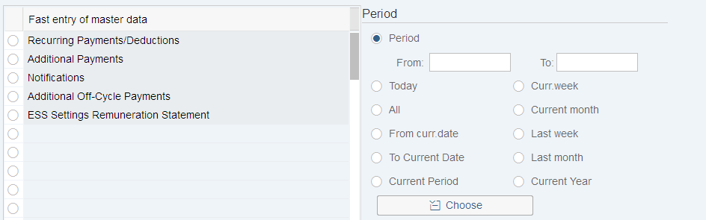
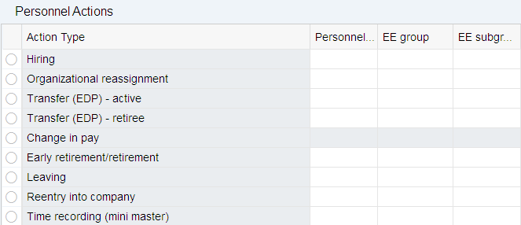
Maintenance of Infotypes
Infotypes can be maintained in three different ways:
Fast entry
Single infotype maintenance
Personnel action

Slide 21
Agenda
HCM Organizational Structure
HCM Master Data
HCM Processes
  Organizational Management
  Personnel Administration
  Personnel Development
  Personnel Controlling
  ESS/MSS

Slide 22





HCM Processes – Organizational Management
  Model the organizational structure of your enterprise
  Create, change and delimit organizational units
  Create, change and delimit jobs and positions
  Analyze an organizational unit to define
  workforce requirements and personnel cost planning
  Create further organizational units for planning
  scenarios or simulations

Slide 23

HCM Processes – Personnel Administration
  Creating and maintaining personnel master data
  Plausibility checks
    may be performed to detect errors
    prevent the transfer of incorrect data
  Automatic history
    is created when changing master data
    may be used for reporting and the verification of data integrity
  Personnel administration sets the data basis for subsequent processes in Human Resource Management and reporting

Slide 24
Personnel Controlling – Ad-hoc Query
Ad-hoc Queries are a tool for analysing data from personnel management
Infoset
Personnel Administration
Payroll
IT 0001
IT 0006
IT 0007
…
Gross result
Optional data
Church tax
…
Choose selection fields
Choose output fields
Export ad-hoc query
Save ad-hoc query
Notes:
An Ad-Hoc Query is an easy and effective tool for the creation of user-defined reports. The title “Ad-hoc Query“ is exclusively used within the HCM module. Outside the HCM module, this tool is named “InfoSet Query“.
When creating an ad-hoc query, the user can decide which data fields shall be provided as selection criteria for the report. Data fields from the different components of the HCM module can be chosen. In addition, the user can chose the data fields to be displayed in the output of the report as well as the output form of the report. Ad-hoc query's can be saved and do not have to be regenerated when calling the query. In order to limit the number of data field visible for a user, InfoSets can be generated in customizing. In these InfoSets, data fields that are available for ad-hoc query users. The InfoSets are assigned to a user with the help of a user group.

Slide 25
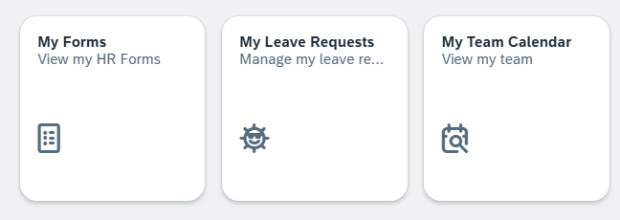
Employee Self-Service (ESS)
Modern web interface for employees
Enables personal data to be maintained independently of time and location
Access to numerous administrative functions that are normally performed by other departments
Employees are responsible for updating their own data
Employees can perform the following activities via the ESS:
  Submitting travel expense reports
  Searching the employee directory
  Viewing the team calendar
  Updating/changing personal data
  Applying for employer benefits
  Documenting working hours
  Updating bank details
  Registering/applying for training courses
  Applying for absences

